Slide 1


Sets

Slide 2



Slide 3


Slide 4


Slide 5




Slide 6

Sets can be represented graphically using Venn diagrams, named after the English mathematician John Venn, who introduced their use in 1881. In Venn diagrams the universal set U, which contains all the objects under consideration, is represented by a rectangle.

Slide 7
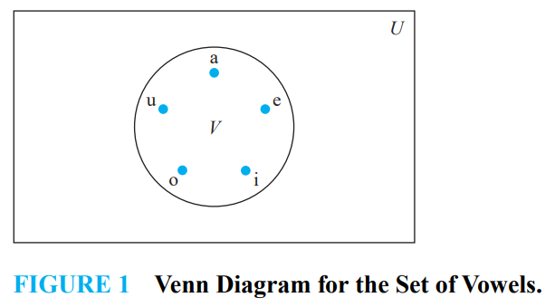

Slide 8





Slide 9

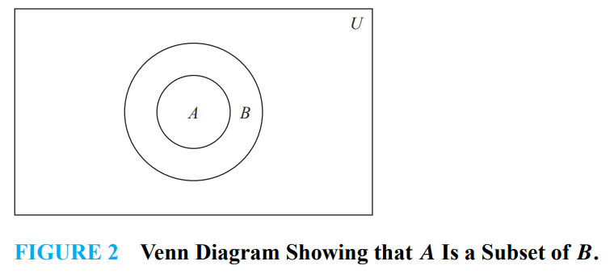

Slide 10





Slide 11



Slide 12




Slide 13


Slide 14






Slide 15


Slide 16


